Slide 1


Slide 2

ArIES
Intro Talk
Artificial Intelligence & Electronics Society

Slide 3

ArIES

Slide 4

Overview of our Intro Talk
Areas
Quiz
Projects
Events
Competitions
Timeline

Slide 5
What do we do ?
WORKSHOPS
LECTURES
PROJECTS
COMPETITIONS
&
HACKATHONS

Slide 6
01
Areas being explored
Different areas/fields our group is mainly involved in

Slide 7




AREAS
Add Some Brief Text Here As a Subtitle and Remember This is Just a Demo Text So Consider Replacing This With Your Own Information
Artificial
Intelligence
Embedded
Systems
Internet of Things(IoT)
Augmented and Virtual Reality

Slide 8
02
Projects under ArIES

Slide 9
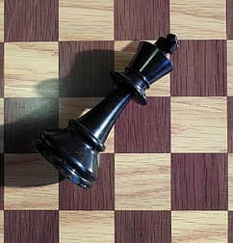

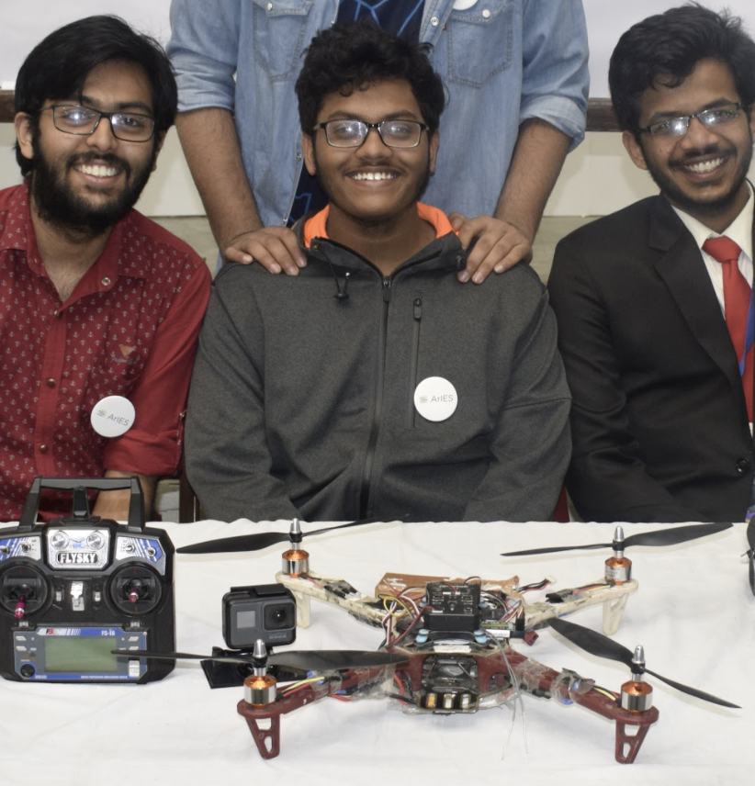
Chess Playing Bot
Dodging Drone
A bot which can play chess in realtime with real person. This bot was made with the help of Convolutional Neural Network.
This drone can dodge both static and dynamic obstacles,which is one of the biggest obstacle in large scale deployment of a large scale drone based delivery network.

Slide 10
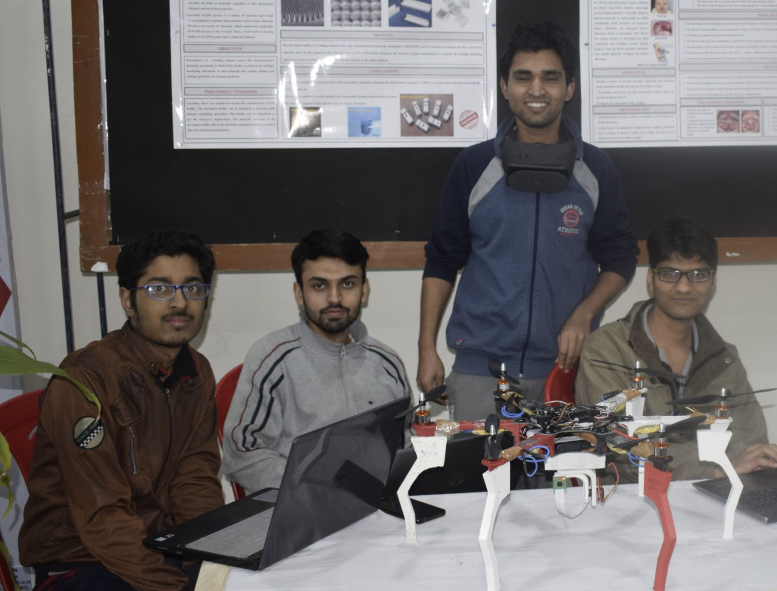
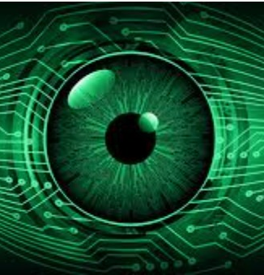
Flood Rescue Drone
Eye Controlled
Wheelchair
The aim is to survey the flood hit area autonomously, detecting the victims trapped in remote areas and sending their GPS location to the rescue base leading to efficient rescue operations.
The user controls the direction of the wheelchair by simply moving their eye in that direction,and stop the wheelchair by closing their eyes for 1 s.

Slide 11
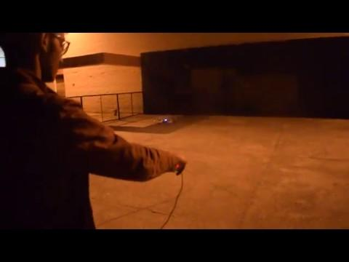
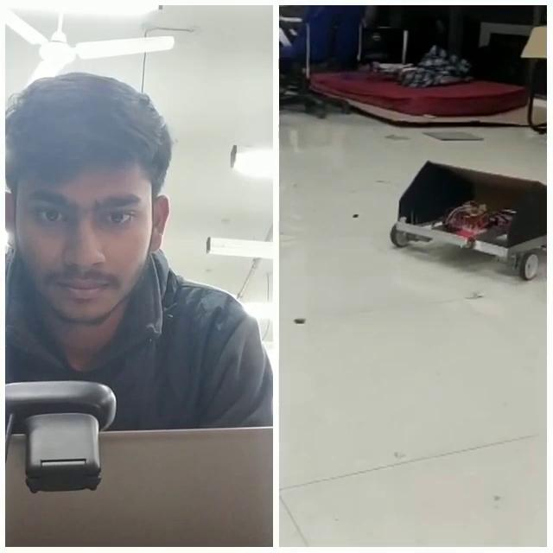

Slide 12

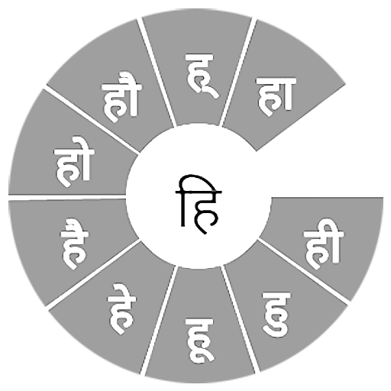


Some other projects we have undertaken
Real time adversarial attack on surveillance
Automatic speech recognition system for hindi
Image processing filters implementation in Verilog
Temple Run VR game

Slide 13
03
Events

Slide 14

Srishti

Slide 15
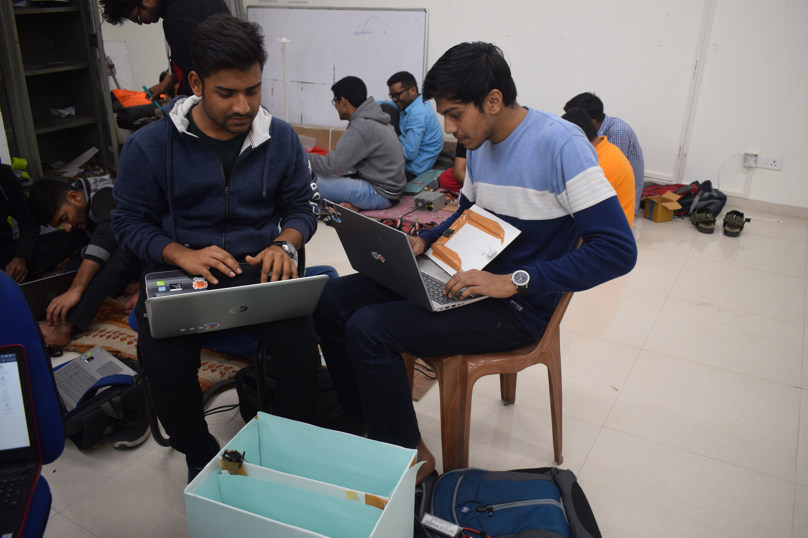
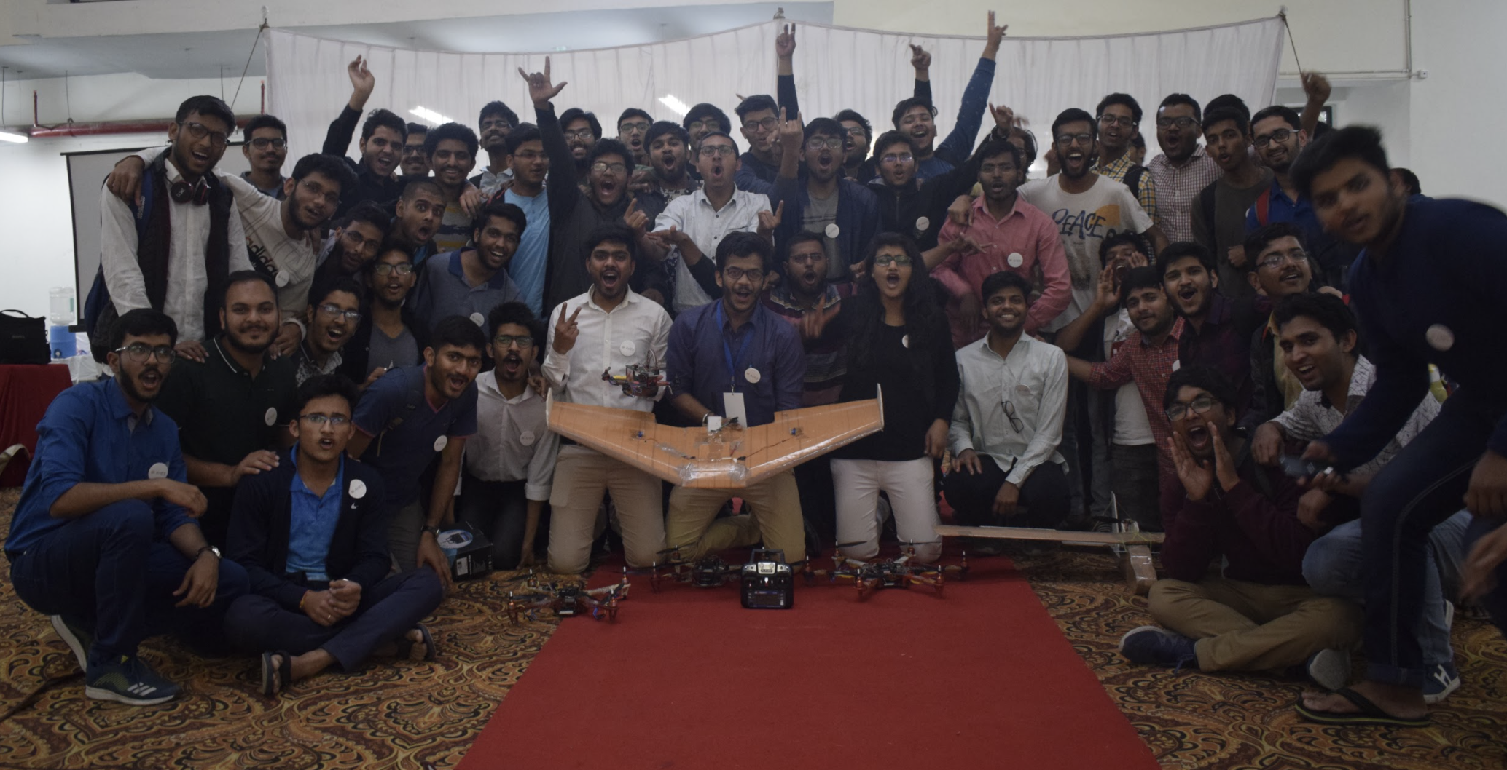

Laser Harpoon - won the best project in
Srishti 2019

Slide 16
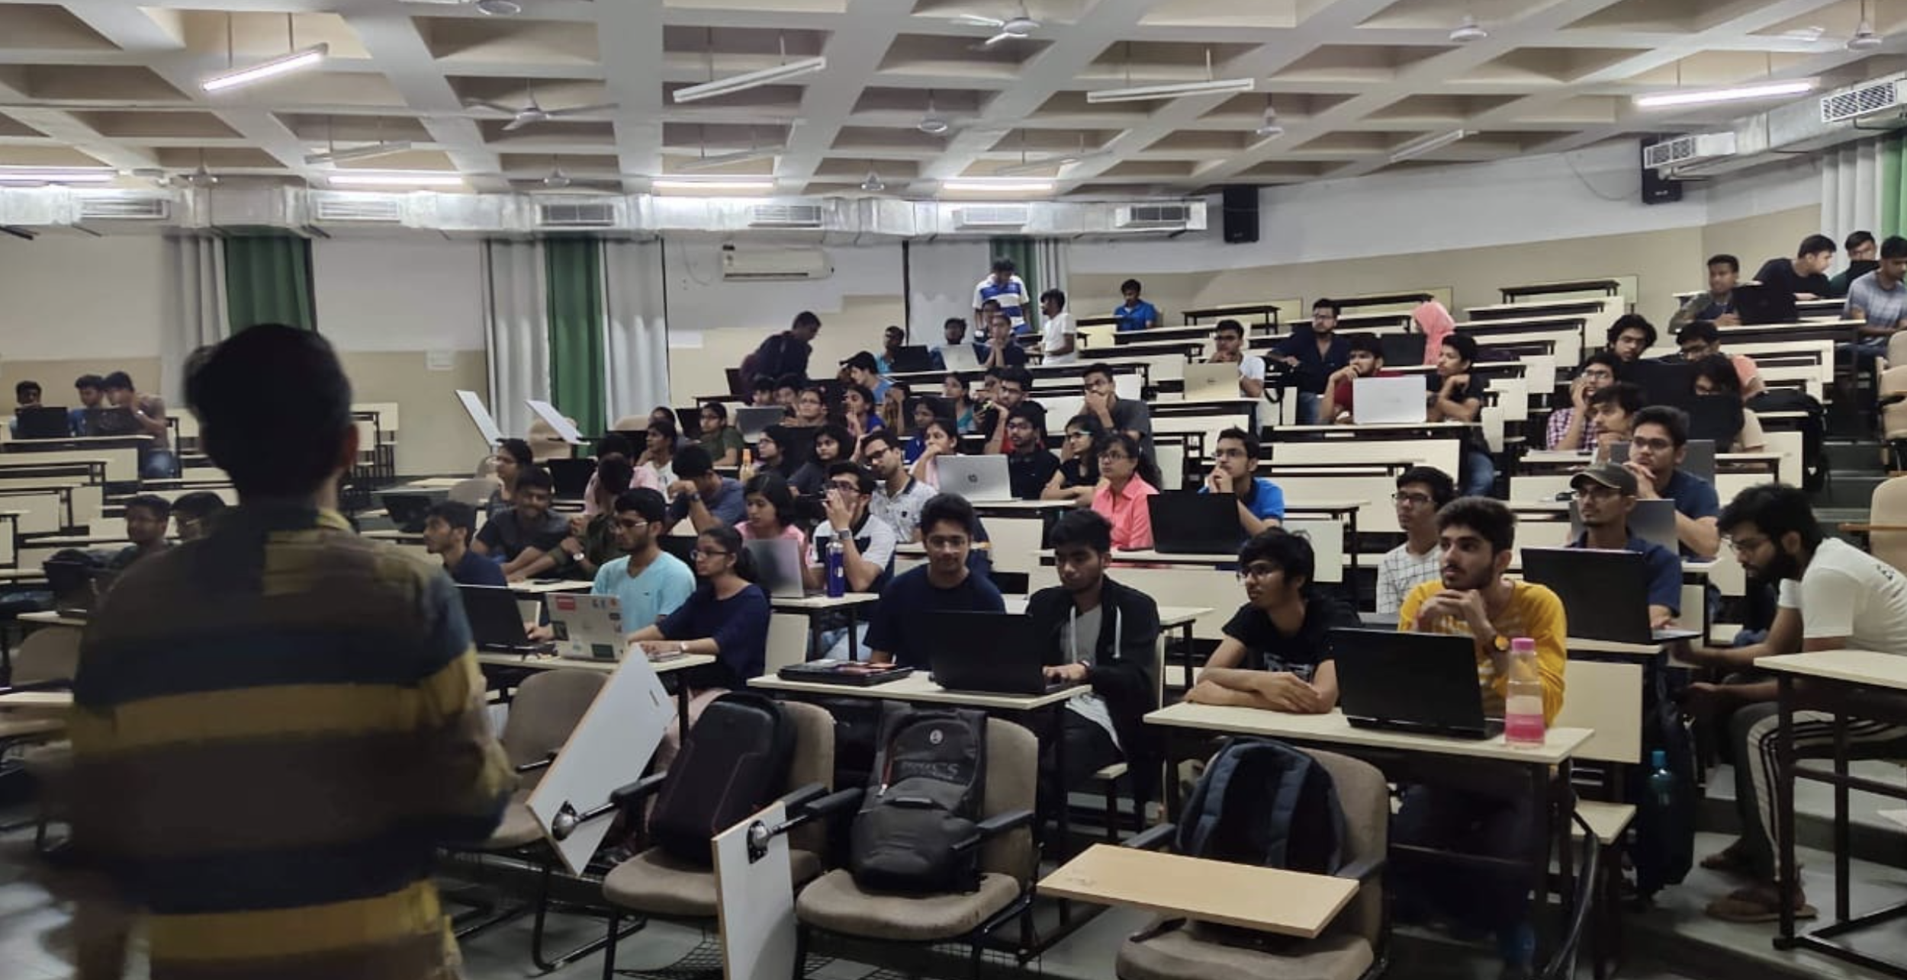
Workshops & Lectures
We hold many exciting workshops and lectures for first-year students on topics for them to develop an interest in the fields of AI and robotics.
Following are some topics we usually cover in them :-
Printed Circuit Boards
OpenCV
Digital Electronics
Machine Learning
Augmented and Virtual Reality

Slide 17


Slide 18
Name 5 popular programing languages used in Artificial Intelligence.
Python
Lisp
Java
R
Prolog

Slide 19
Name 5 real world applications of AI.
E-mail spam filter.
Self driving cars.
Directly interacting with chatbots or virtual assistant using NLP (natural language processing) e.g. Alexa , Siri, Google Assistant.
Similar product recommendation in online shopping apps.
To predict the future patterns in the finance and market (since machines can handle a huge amount of data in shot time, they can observe the data and predict the future more accurately.

Slide 20
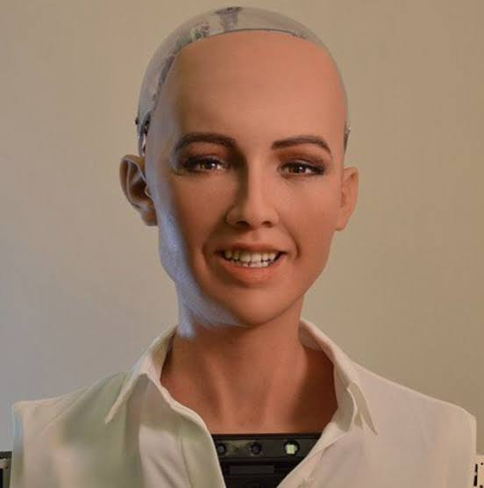
Name the first AI robot that was given a citizenship of a country. Also name the company that built it.
Robot : Sophia
Company : Hanson Robotics

Slide 21

What is Arduino ?
Arduino is an open source electronic platform based on easy to use hardware and software.
It has a microcontroller like “Arduino uno” and “Arduino mega” , and a software or IDE to program the microcontroller.

Slide 22


Identify these people.
Andrew Ng
Elon Musk

Slide 23
04
Competitions
Some of the competitions our group participates in

Slide 24
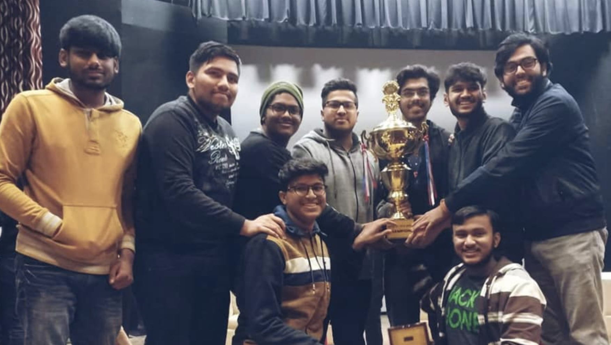
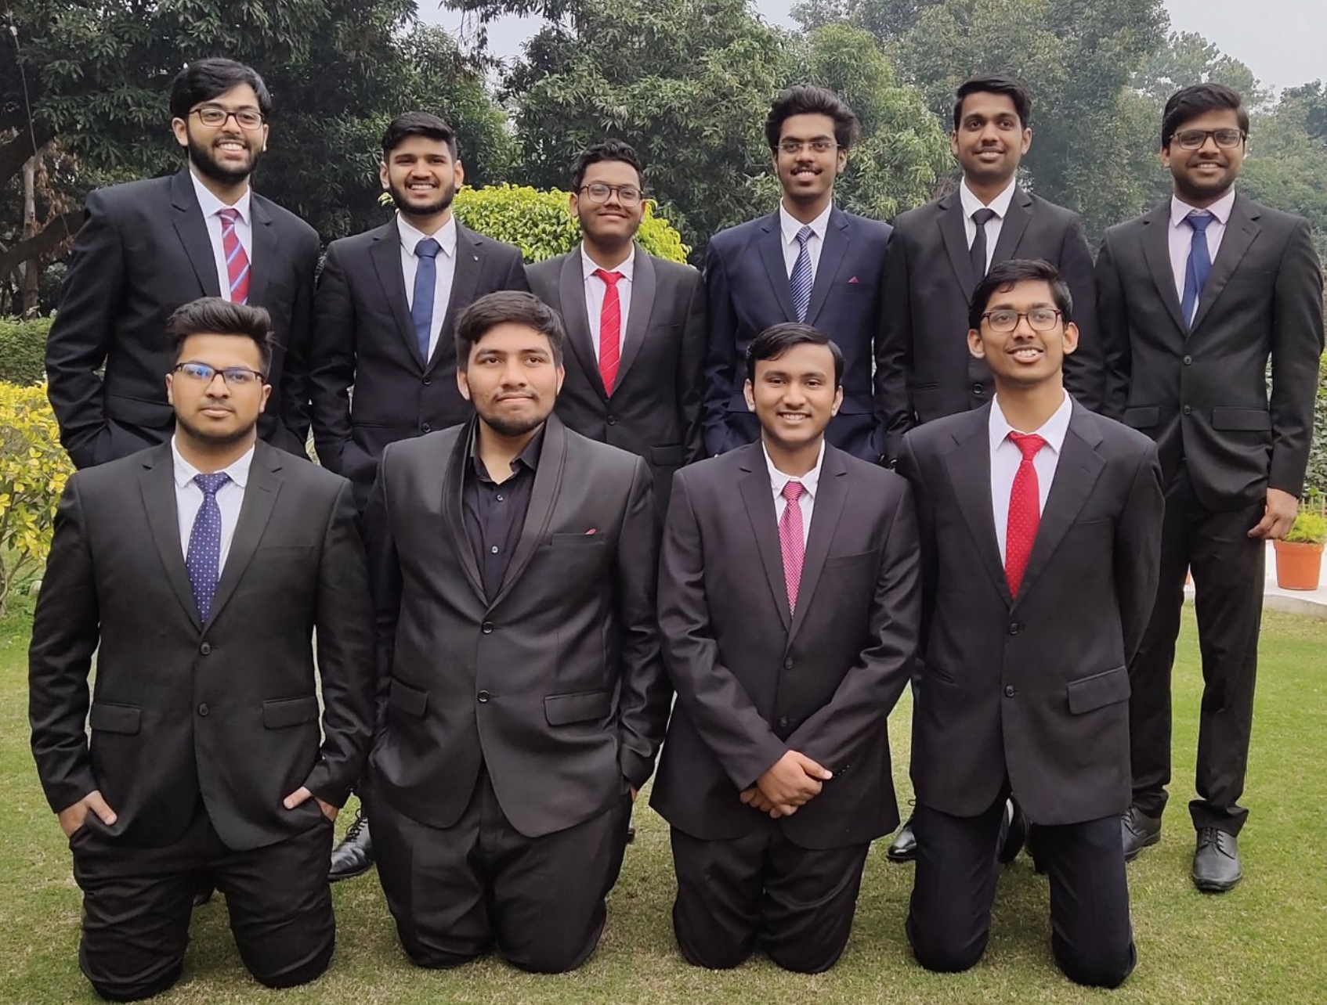
Annual Inter IIT Tech Meet
D.R.D.O SASE’s
UAV CHALLENGE
ENGINEER’S CONCLAVE EXHIBITION
A Team of 10 members from our group, comprising of 6 3rd years and 4 second years took part in the DRDO SASE UAV challenge organised under the banner of Inter IIT Tech meet. Their consistent efforts helped them secure the Bronze Medal
Also organised under the banner of Inter IIT Tech Meet, Engineers Conclave is the best place for students from all IITs to showcase their work and learn from each other

Slide 25

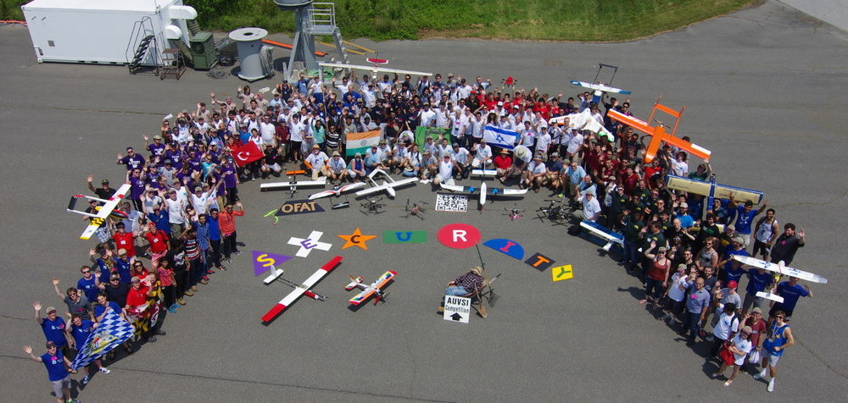

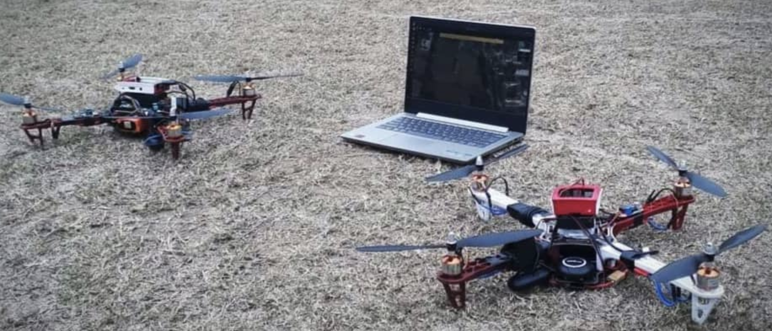
AUVSI SUAS
VALEO INNOVATION CHALLENGE
This Challenge encourages students from all over the world to innovate and offers the winner the opportunity to create their own start up. A team from ArIES successfully completed the challenge in France
The AUVSI SUAS Competition is designed to foster interest in Unmanned Aerial Systems (UAS), stimulate interest in UAS technologies and careers, and to engage students in a challenging UAS mission.

Slide 27
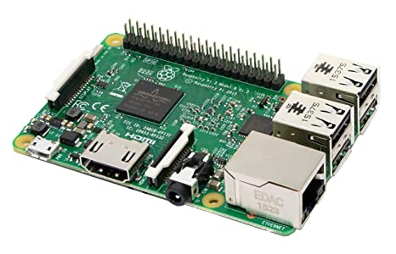
What is Raspberry pi ?
The Raspberry Pi is a low cost ,credit-card sized computer that plugs into a computer monitor or TV, and uses a standard keyboard and mouse. Its capable of doing everything you’d expect a desktop computer to do, from browsing the internet and playing high definition video, to making spreadsheets, word-processing and playing games.

Slide 28
What are accelerometer and gyroscope ?
(select correct option)
Sensors
Actuators
Sensors
Simulator
IDE

Slide 29







2. 3. 4.
5. 6. 7.
Name the products which use the following logos.
ALEXA
CORTANA
MATHWORKS
RASPBERRY PI
TENSOR FLOW
ARDUINO
GOOGLE ASSISTANT

Slide 30
How AI, Machine Learning, and Deep Learning differ from each other ?
AI
It is used to create intelligent machines that can mimic human behaviour.
MACHINE LEARNING
It is a subset of AI that learn from past data and experiences.
DEEP LEARNING
It is a subset of machine learning that is inspired by the human brain cells or ‘neurons’ and it imitate the working of human brain.

Slide 31

A company recently did an experiment in which they implanted a microchip in the brain of a pig and in the future they want to implement it to humans also .
Name the company.

Slide 32
Name any 5 types of sensors that are used in smartphones.
Proximity sensor
Fingerprint sensor
Accelerometer
Gyroscope
Ambient light sensor
Hall effect sensor
QR code sensor

Slide 33
05
Timeline
In what sequence do the major events of our section unfold

Slide 34

MAJOR EVENTS
Recruitment
(through Projects)
Inter IIT
May
Winters
2021, June
Summers
March
Srishti
AUVSI SUAS

Slide 35
06
ArIES’ important links
You might want to keep in touch with us to stay updated

Slide 36



Facebook Group: ArIES IITR
https://www.facebook.com/groups/ariesiitr/?ref=bookmarks
Facebook Page: ArIES IITR
https://www.facebook.com/ariesiitr/
For queries, mail us at
aries.iitr@gmail.com
To know more about previous year’s projects, check out our github repository
https://github.com/aries-iitr
Check out our website at
https://ariesiitr.herokuapp.com/

Slide 37
THANKS FOR ATTENDING!!!
Does anyone have any questions?

